Slide 1
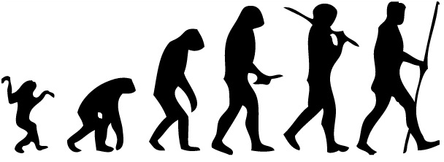

Evolutionary Theories
[Instructor Name]
[Class and Section Number]
Notes:
The “Evolution Theories in Psychology” module can be taught over a single class period.
Start off your lecture with a bold statement: We can see evolution in action almost anywhere that we look today. In fact, there is a good chance that you are evolving at this very minute, or at least carrying random DNA mutations which can be passed onto your children, giving them either a better or worse chance of surviving in this world.
We recommend breaking up this lecture in the middle of the class period to conduct a fun activity and review a related special topic about Darwinian theory and family bonds!
Technical Note: These slides may contain simple click animation so that you can focus students’ attention on a particular question, a selection of text, or an image and not have them be distracted by reading ahead. You can either preview the sequence of animation by going through the slides in slideshow view, visiting the animations tab, or reviewing the slide notes. In the notes you will see a cue - (Click) – that corresponds to each animation.
You will also find hyperlinks to outside videos at various places in the slides. These hyperlinks are embedded in text and indicated by color and in the notes section.

Slide 2
Overview
The Basics
Sexual Selection Theory
Gene Selection Theory
Evolutionary Psychology
Sexual Strategies Theory
Error Management Theory
Notes:
The purpose of this slide is to provide students with an overview of the material that will be covered during the lecture.

Slide 3
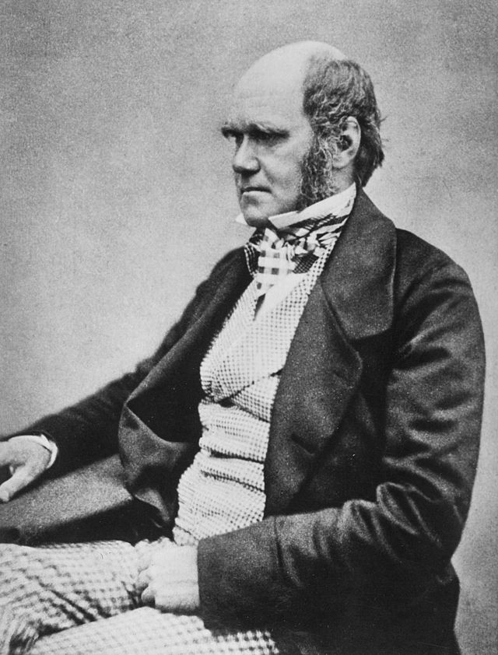
The Basics
Evolution –
Change over time driven by successful reproduction via natural selection
Notes:
This slide formally introduces/defines evolution and natural selection. Pictured is Charles Darwin, a British naturalist best known for his contributions to evolutionary theory.
Discussion question: What do you think evolution means, and why is it important for our survival?
You are likely to get many responses. Allow students to share a variety of answers before showing the definition on the slide and moving on to the explanation below.
(Click) Change over time driven by successful reproduction via natural selection
Explanation: Evolution simply means change over time. Many equate evolution with survival selection, or “Nature, red in tooth and claw.” But survival is only important inasmuch as it contributes to successful reproduction. Differential reproductive success, not differential survival success, is the engine of evolution by natural selection. You can survive a century. But if you fail to mate, you fail to reproduce, and your genes die along with your body. Every mating success by one person comes at a loss to rivals. Yet, we are all, every living human, evolutionary success stories. Each of us descended from a long and unbroken line of ancestors who triumphed over others in the currency of survival (at least long enough to mate) and reproductive competition. As their descendants, we inherited the adaptive mechanisms of a mind designed for success.

Slide 4
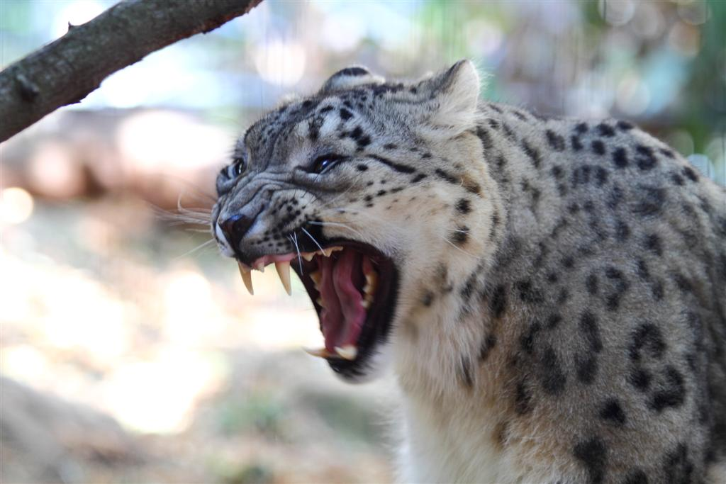
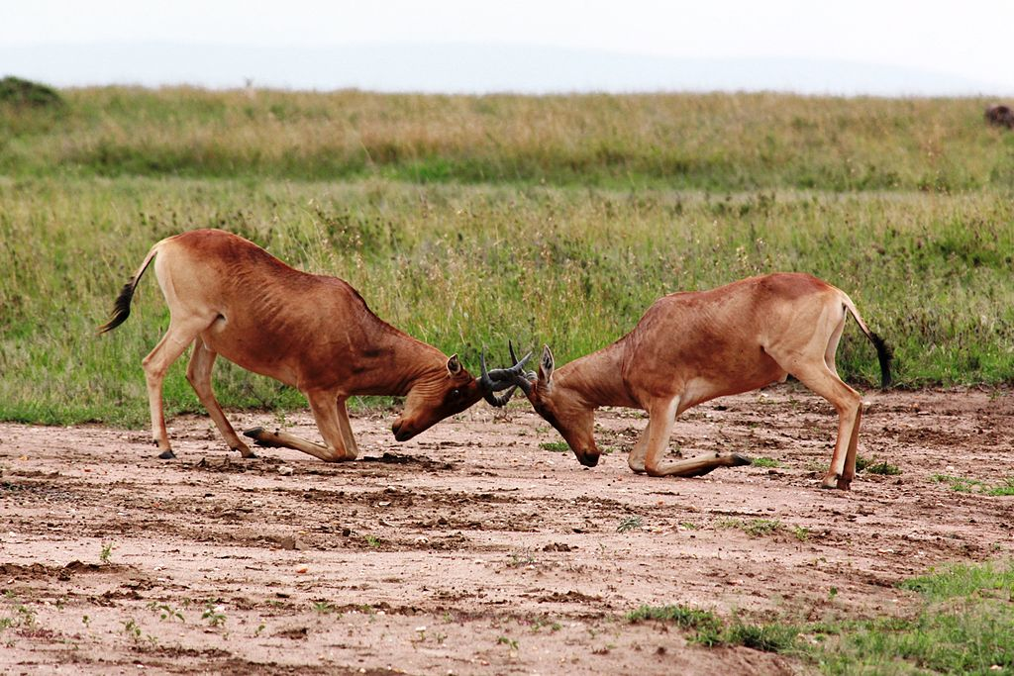
The Basics
Survival Adaptations Mate Competition
Notes:
This slide introduces two classes of evolutionary adaptations: survival adaptations and adaptations driven by mate competition.
Discussion question: How do these images illustrate survival adaptations and mate competition?
Explanation: Pictured on the left is a snow leopard showing it’s teeth, which is intended to allude to the survival adaptations relevant to handle the hostile forces of nature (e.g., protection from predators, ability to hunt). Pictured on the right are male hartebeests locking horns as they compete for the ability to mate. The male that shows dominance has a greater chance of mating and passing on his genes.
At the broadest level, we can think of organisms, including humans, as having two large classes of adaptations—evolved solutions to problems that historically contributed to reproductive success. One class is survival adaptations—mechanisms that helped our ancestors to handle the “hostile forces of nature”, such as food shortages, extremes of temperature, dangerous predators, and parasites. Thus, humans have evolved specialized food preferences (for fat and sugar), sweat glands and shivering mechanisms, and fears of snakes, spiders, darkness, heights, and strangers. These fears helped our ancestors to avoid the hostile forces of nature. The second major class of adaptations is composed of those that aided our ancestors in mate competition, which brings us to a second evolutionary theory proposed by Charles Darwin—sexual selection theory.

Slide 5
Overview
The Basics
Sexual Selection Theory
Gene Selection Theory
Evolutionary Psychology
Sexual Strategies Theory
Error Management Theory
Notes:
The purpose of this slide is to provide students with an overview of the material that will be covered during the lecture.

Slide 6
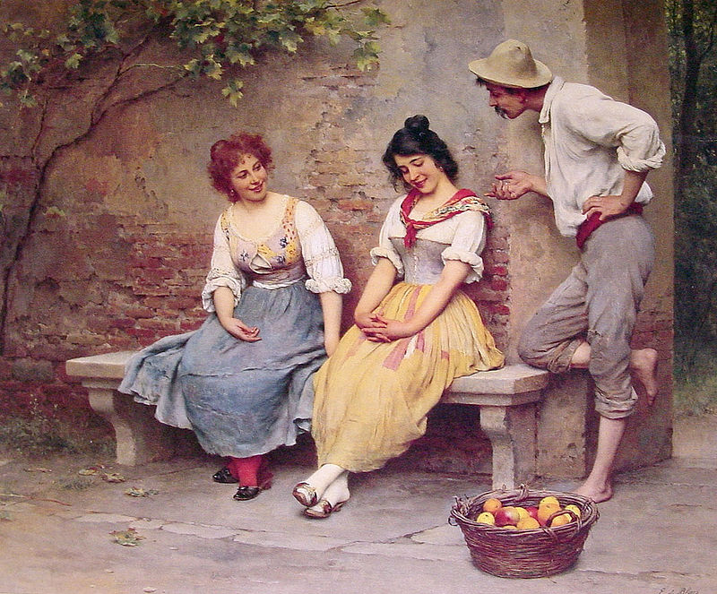
Sexual Selection Theory
Sexual Selection – The evolution of characteristics not because of survival advantage, but because of mating advantage.
Notes:
This slide explores Darwin’s revelations regarding the influence of mating advantage on evolution. The theory of sexual selection is formally introduced. Pictured is a painting entitled The Flirtation by Eugene de Blaas.
Discussion question: What are some examples of sexual selection from the animal kingdom, adaptations that don’t contribute to the animal’s survival, but rather help the animal attract a mate?
Explanation: Darwin noticed many phenomena that could not be explained by “survival selection.” These included the brilliant plumage of peacocks, the large antlers of male stags, the wattles of roosters, and other structures that seem to be detrimental to survival. The peacock’s plumage, for example, is like a neon sign to predators advertising “fast food!” Darwin’s answer was the theory of sexual selection—the evolution of characteristics not because of survival advantage, but rather because of mating advantage.

Slide 7
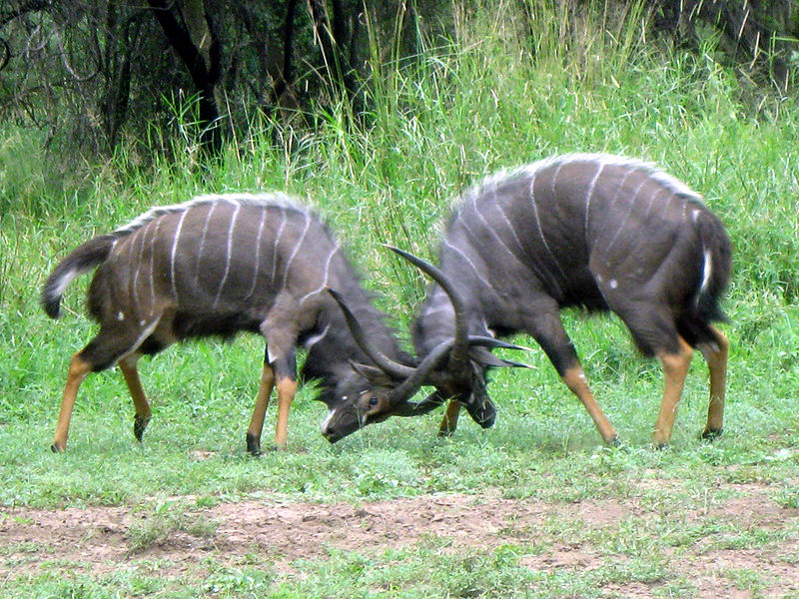
Sexual Selection Theory
Intrasexual Competition – Members of the same sex compete with each other, and the winners gain mating access to the opposite sex.
Notes:
This slide helps to facilitate a discussion regarding one of the two processes through which sexual selection occurs: intrasexual competition. Pictured are two Kudu bulls locking horns as they vie for a mate.
Explanation: Sexual selection occurs through two processes. The first, intrasexual competition occurs when members of one sex compete with each other, and the winners gain mating access to the opposite sex. Male stags, for example, battle with their antlers, and the winner (often stronger and with more formidable antlers) gains mating access to the female. Human males sometimes also compete with each other in physical contests—boxing, wrestling, karate, or group-on-group contests such as football. Whatever qualities lead to success in competition are passed on with greater frequency due to their association with mating success.

Slide 8
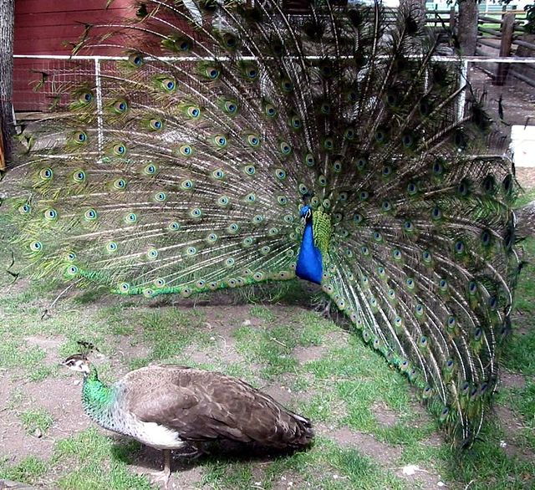
Sexual Selection Theory
Intersexual Competition – Members of one sex prefer certain qualities in mates.
Notes:
This slide helps to facilitate a discussion regarding the second of two processes through which sexual selection occurs: intersexual competition. Pictured is a peacock displaying its plumage in an effort to court a peahen.
Explanation: The second process of sexual selection is preferential mate choice, also called intersexual selection. In this process, if members of one sex prefer certain qualities in mates, such as brilliant plumage, signs of good health, or even intelligence, those desired qualities get passed on in greater numbers simply because their possessors experience more mating success. The luminous plumage of peacocks, for example, exists due to a long evolutionary history of peahens’ preference for males with brilliantly colored feathers.
In all sexually reproducing species, adaptations in both sexes (males and females) exist due to the process of survival selection and sexual selection. Indeed, in humans we have “mutual mate choice,” which means that both women and men do the selecting. And in long-term mates, both genders value qualities such as kindness, intelligence, and dependability—qualities that make them good partners and good parents.
Discussion question: As we see in the picture, male peacocks rely on their fancy feathers to attract a mate. What are some behaviors and characteristics that male and female humans use to attract mates?

Slide 9
Overview
The Basics
Sexual Selection Theory
Gene Selection Theory
Evolutionary Psychology
Sexual Strategies Theory
Error Management Theory
Notes:
The purpose of this slide is to provide students with an overview of the material that will be covered during the lecture.

Slide 10

Gene Selection Theory
Genes increase their own replication in two ways:
Influence individual bodies to survive & reproduce
Influence individual bodies to help other bodies that are likely to contain copies of themselves
Notes:
This slide introduces gene selection theory and identifies the two ways in which genes influence their own replication. The picture is in reference to the altruistic adaptation example provided in the text below.
Darwinian Grandparenting Activity: (10 minutes) For detailed instructions see IM > Biology as a Basis of Behavior > Module 3: Evolutionary Theories in Psychology > Activities/Demonstrations
Ask students to rate each of their grandparents on a scale from 0-100 (with 0 = cold/negative feelings and 100 = warm/positive feelings).
Then ask students to rank each grandparent from 1-4 based on the rating they listed.
Finally, ask students for a show of hands for which grandparent they ranked as 1st and which grandparent they ranked as 4th.
Discussion question:
From an evolutionary standpoint, why do you think our class got this result?
Answers will vary.
Explanation: Research demonstrates that individuals generally indicate that they are emotionally closest with their maternal grandmother (mother’s mother) and the least emotionally close to their paternal grandfather (father’s father). According to the evolutionary perspective, grandparent investment is related to genetic certainty. Women are a 100% certain of their maternity, whereas men can be unsure about their paternity. Now, if you look at it from the viewpoint of grandparents, one’s mother’s mother will be a hundred percent sure that she is the mother of her daughter, and her daughter will also be a 100% certain of her genetic contribution to her children. Thus, a maternal grandmother will be absolutely certain that her grandchildren carry her genes.
Discussion question: Research has also indicated that the maternal grandfather is ranked higher than the paternal grandmother. This is puzzling because both of these grandparents carry one uncertainty. The mother’s grandfather may be unsure that he is his daughter’s father. The father’s grandmother could be unsure that her son is the father of his children. So, why is one ranked higher than the other?
Explanation: One explanation set forth by researchers (there may be more), which has some evidence behind it, is related to the possibility of investing one’s resources elsewhere. If the paternal grandmother is also a maternal grandmother (i.e., her daughter has children), she has an alternative in which she is absolutely sure that she is biological grandmother of her grandchildren, therefore, she is more likely to invest less resources in her son’s children!
Instructor’s notes: Share the definition of gene selection theory: the modern theory of evolution by selection by which differential gene replication is the defining process of evolutionary change. In modern evolutionary theory, due to the discovery of the gene (the unit of inheritance) and its implications, all evolutionary processes boil down to differential gene reproduction or replication. Genes evolve, or increase in frequency, that have effects that increase their own replicative success relative to competing genes.
(Click) Genes increase their own replication in two ways.
(Click) Influence individual bodies to survive & reproduce
Explanation: First, they can influence the bodies in which they reside to survive and reproduce (individual reproductive success or fitness).
(Click) Influence individual bodies to help other bodies that are likely to contain copies of themselves
Explanation: Second, they can influence the bodies in which they reside to help other bodies that are likely to contain copies of themselves—genetic relatives—to survive and reproduce (inclusive fitness). So the next time you wonder why parents tend to fund their own children’s college education (pictured), and not that of the kids next door, altruistic adaptations to help close kin may provide the most compelling answer.
Understanding differential gene replication is the key to understanding modern evolutionary theory. It also has profound implications for many evolutionary psychological theories. Nonetheless, for many purposes, we can ignore genes and focus primarily on adaptations in individuals that evolved because they helped our ancestors to survive or because they helped our ancestors to reproduce.

Slide 11
Overview
The Basics
Sexual Selection Theory
Gene Selection Theory
Evolutionary Psychology
Sexual Strategies Theory
Error Management Theory
Notes:
The purpose of this slide is to provide students with an overview of the material that will be covered during the lecture.

Slide 12
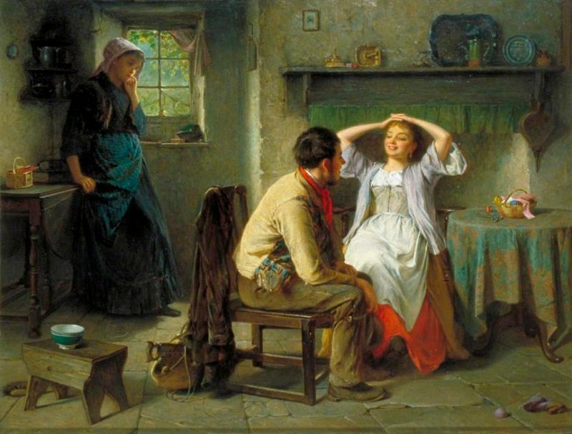
Evolutionary Psychology
Psychological Adaptations - Mechanisms of the mind that evolved to solve specific problems of survival or reproduction.
Notes:
This slide introduces the concept of psychological adaptations. Pictured is a painting entitled Jealousy and Flirtation.
Explanation: Evolutionary psychology applies the lenses of modern evolutionary theory to understanding the mechanisms of the human mind. It focuses primarily on psychological adaptations—mechanisms of the mind that evolved to solve specific problems of survival or reproduction. Most evolutionary psychologists conceptualize psychological adaptations as information-processing devices: inputs, procedures, and outputs. To use a physiological example, a callus-producing adaptation would have input such as repeated friction to the skin; procedures that dictate the growth of new skin cells to the afflicted area; and actual calluses as output that function to protect the underlying structures beneath the skin.
Discussion question: How is this painting an example of psychological adaptation?
Answer: It’s an example because sexual jealousy is a type of psychological adaptation. The painting depicts a young woman (possibly the male’s romantic partner) in the back corner appearing jealous of the attention the man is showing to another woman. This solves the problem of reproduction. A jealousy adaptation might contain inputs such as a romantic partner flirting with someone else or a mate poacher flirting with one’s partner; the procedures would be decisions that include assessing the physical formidability of the rival and gauging one’s partner’s interest in the mate poacher; and the behavioral output might range from vigilance (e.g., snooping through a partner’s email) to violence (e.g., threatening the rival).
Instructor’s note: Point out that evolutionary psychology is fundamentally an interactionist framework. Neither calluses nor jealousy simply pop up without the relevant environmental input. Indeed, adaptations are designed to deal with environmental problems, be they physical (damage due to friction to the skin) or social (mate poachers trying to lure your romantic partner).
Discussion question: What might be other examples of psychological adaptations that solve problems of survival or reproduction?
Answer: Hypothesized psychological adaptations are wide-ranging and include food preferences (solutions to food selection problems), habitat preferences, mate preferences, and specialized fears to the hostile forces of nature. They also include many adaptations to group living, such as adaptations to cooperate and form friendships, detect and avoid cheaters, aggress and inflict costs on rivals, deal with status hierarchies, invest in children, and bestow altruistic acts on genetic relatives.

Slide 13


Evolutionary Psychology
Psychological adaptations interact with culture
Notes:
This slide acknowledges the influence of culture within the context of psychological adaptations. Pictured are the flags of the United States (left) and Japan (right).
Instructor’s note: Briefly explain that evolutionary psychology is interactionist because it includes cultural input as central to the activation or suppression of psychological adaptations.
Discussion question: The United States is generally seen as having an individualistic culture, while Japan’s culture is more collectivistic. With this in mind, let’s talk about what characteristics might give someone in the United States a higher status, and therefore greater chances of finding a mate, that would not be as desirable in Japan.
Answer: Although status within the group is critical to acquiring reproductively relevant resources (including desirable mates) in all cultures, in individualistic cultures such as the United States, status is heavily determined by individual accomplishments. In more collectivist cultures, such as Japan, status is more heavily determined by contributions to the group and the group’s success.
Discussion question: What other cultural norms might affect psychological adaptations?
One possible answer: The importance placed on virginity is a mate preference highly susceptible to cultural input. Cultural norms of premarital sex influence the degree to which men and women value virginity in potential marriage partners. Evolutionary psychology, in short, does not predict rigid robotic-like “instincts,” but rather flexible environmentally contingent and culturally contingent adaptations.

Slide 14
Overview
The Basics
Sexual Selection Theory
Gene Selection Theory
Evolutionary Psychology
Sexual Strategies Theory
Error Management Theory
Notes:
The purpose of this slide is to provide students with an overview of the material that will be covered during the lecture.

Slide 15
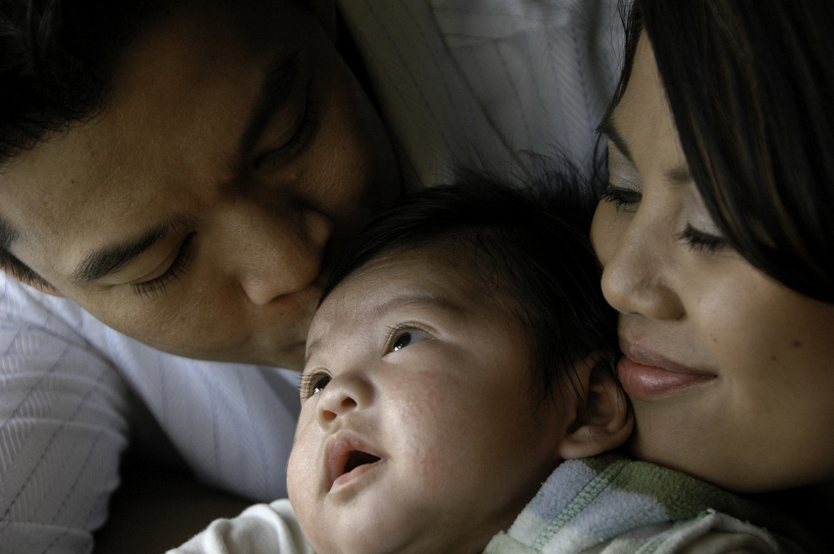
Sexual Strategies Theory
Sexual Strategies Theory – Humans have evolved a menu of mating strategies, which are selected based on culture, social context, parental influence, and personal mate value.
Notes:
This slide introduces the sexual strategies theory.
Instructor’s note: Begin by giving an overview of sexual strategies theory:
Sexual strategies theory is based on sexual selection theory. It proposes that humans have evolved a menu of mating strategies, both short term and long term. Furthermore, the strategy an individual uses depends heavily on culture, social context, parental influence, and personal mate value (desirability on the mating market). In its initial formulation, sexual strategies theory focused on sex differences in human mate preferences and corresponding strategies of mate competition (Buss & Schmitt, 1993). It starts with sex differences in parental investment—the minimum investment needed to produce a child. For women, the investment is large, including internal fertilization and gestation and a nine-month pregnancy. For men, the minimum investment to produce the same child is considerably smaller, simply the act of sex.
Discussion question: How might these differences in parental investment affect the decision-making practices of women and men?
Answer: In short-term mating, women should be choosier or more discriminating than men; men will, on average, be motivated to engage in more low-investment sexual strategies; men will sometimes deceive women about their long-term intentions in order to have short-term sex; and men will lower their mating standards in short-term mating more than women.
Instructor’s note: Encourage students to explain their answers. The following explanation will help you fill in any holes they leave in their reasoning.
Explanation: These sex differences in parental investment have enormous consequences for human sexual strategies. They suggest that the costs of making a poor mating decision are large for women. They risk getting pregnant by a man who will not invest in her and her children, and perhaps a man with poor-quality genes. Conversely, the benefits of making wise mating decisions are large. For men, however, because they need not invest much, the costs of making a poor sexual decision are lower. A tremendous body of empirical evidence supports these and related predictions (Buss & Schmitt, 2011). Men express a desire for a larger number of sex partners than do women. They let less time elapse before seeking sexual intercourse. They are more willing to consent to sex with strangers and are less likely to require emotional involvement in order to have sex. They have more frequent sexual fantasies and fantasize about a larger variety of sex partners. They are more likely to regret missed sexual opportunities. And, they lower their standards in short-term mating, showing a willingness to mate with a larger variety of women as long as the costs and risks are low.
Discussion question: How might these decision-making practices change in relation to long-term mating?
Answer: In long-term mating, both sexes invest tremendously in both the relationship and in resultant children. Consequently, the theory predicts that both sexes should be extremely choosy when pursuing a long-term mating strategy. Much empirical research supports this prediction. Many qualities on which women and men choose long-term mates are highly similar—both want mates who are intelligent, kind, understanding, healthy, dependable, honest, loyal, loving, and adaptable.

Slide 16
Sexual Strategies Theory
Women
Possession of resources
Access to resources
Commitment
Men
Youth
Health
Attractiveness
Notes:
This slide is meant to clearly differentiate the preferences of men and women when selecting a mate.
Discussion question: In what ways do you think men and women differ in their long-term mating strategies?
Answers will vary. Allow students to negotiate several answers before revealing the information on the slide.
Answers: Women
(Click) Possession of resources
(Click) Access to resources
(Click) Commitment
Men
(Click) Youth
(Click) Health
(Click) Attractiveness
Discussion question: Why do you think men and women differ in their long-term mating preferences?
Answer: Women and men differ in their preferences for a few key qualities in long-term mating because they have faced somewhat distinct adaptive problems. Ancestral women faced the problem of securing a long-term mate willing and able to invest resources in them and their children. Consequently, modern women have inherited from their successful ancestral mothers a desire for mates who possess resources, who have qualities linked with resource acquisition (e.g., ambition, drive, industriousness), and who are willing to commit those resources to her. Men, in contrast, faced the problem of securing a woman who was highly fertile, who could bear his offspring. Cues to youth and cues to health are both cues to fertility, and these cues are heavily conveyed by physical appearance. Consequently, worldwide, men more than women place a greater premium on long-term mates who are physically attractive and relatively young. These sex differences are universal in humans. They were first documented in 37 different cultures, from Australia to Zambia (Buss, 1989), and have been replicated by dozens of different researchers in dozens of additional cultures (for summaries, see Buss, 2012).
Discussion question: What variables might affect these traditionally consistent mating preferences, causing men and women to change their preferences?
Answer: Mating preferences and mating strategies are not invariably implemented in actual behavior. People can’t always get what they want. Those with a superiormate value, highly desirable on the mating market, are better able to implement their preferred mating strategies. Other contexts influencing mating strategies include sex ratio (percentage of men to women in the mating pool), cultural practices such as arranged marriage (which reduce individual freedom of mating strategy), strategies pursued by others (e.g., if everyone else is pursuing short-term mating, it’s difficult to implement a long-term mating strategy), parasite prevalence (which increases the cultural importance placed on physical appearance, since parasites degrade appearance), and many others.
In sum, sexual strategies theory, anchored in sexual selection theory, predicts a menu of mating strategies, sex differences in short-term mating and some long-term mate preferences, sexual similarity on many mate preferences, and psychological sensitivity to a host of personality, social, cultural, and ecological contexts.

Slide 17
Overview
The Basics
Sexual Selection Theory
Gene Selection Theory
Evolutionary Psychology
Sexual Strategies Theory
Error Management Theory
Notes:
The purpose of this slide is to provide students with an overview of the material that will be covered during the lecture.

Slide 18
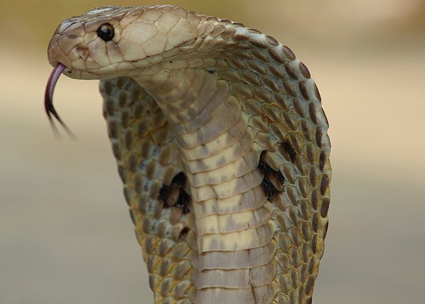
Error Management Theory
Error Management Theory –
Whenever making a judgment in the face of uncertainty, selection will create cognitive biases that function to minimize costly errors.
Notes:
This slide introduces the error management theory.
Instructor’s note: Present this scenario to the class: Consider walking through the woods at dusk. You hear a rustle in the leaves on the path in front of you. It could be a snake. Or, it could be just the wind blowing the leaves. Then ask them the following: Would you alter or stay on your path? Why?
Discussion question: How is this cobra related to error management theory?
Answer: The cobra represents a real threat; however, there’s a chance a person could happen upon a cobra or even hold a cobra without being bitten, but most people are not willing to take that chance. This is because there’s a high enough chance of error, of having a very negative experience with a cobra, that humans have evolved to fear and avoid them.
Explanation: Error management theory (EMT) is a theory about the evolution of cognitive biases in the context of judgments and decisions under conditions of uncertainty (Haselton & Buss, 2000; Haselton, Nettle, & Andrews, 2005). The possibility of a snake on the path is an uncertain situation. What are the costs of errors in judgment? If you infer that it’s a dangerous snake and avoid it, the costs are minimal. You simply make a short detour around. If you infer that it is safe when, in fact, there is a dangerous snake, it could cost you your life. If these cost asymmetries repeated themselves generation after generation over evolutionary time, selection would fashion an adaptive bias to err in the direction of avoiding the most costly error. More generally, EMT predicts that whenever there exists a recurrent cost asymmetry of inference and judgment in the face of uncertainty, selection will create cognitive biases that function to minimize costly errors.
Other examples of EMT: EMT is a general evolutionary psychological theory in the sense that it can be applied to many different domains of functioning. The snake example is one in the domain of survival. Other well-documented EMT biases include the visual descent illusion—people overestimate the distance from the top of a mountain looking down by 32% compared to being at the bottom of the mountain looking up (Jackson & Cormack, 2008). Presumably, this visual bias causes people to be especially wary of falling from great heights, which would produce injury and death. Another is the auditory looming bias—people overestimate how close objects are when the sound is moving toward them compared with when it is moving away from them. In the domain of survival problems, it’s better to be safe than sorry, even if being safe means committing a larger number of absolute errors. By doing so, people avoid the most costly errors.

Slide 19
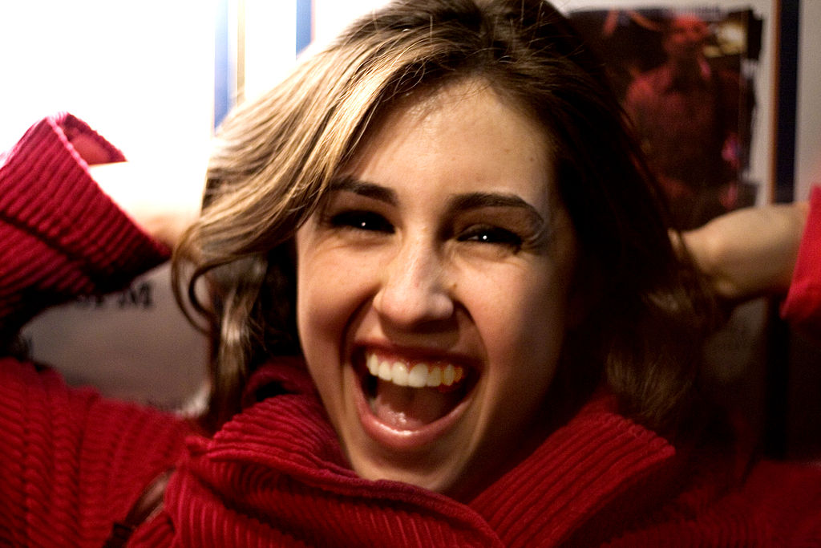
Error Management Theory
Notes:
This slide helps facilitate a discussion regarding the male overperception bias.
Lecture Info:
EMT has also been used to predict adaptive biases in the domain of mating. Consider something as simple as a smile. It’s an inherently ambiguous cue. It may signal sexual or romantic interest. Or it may signal mere friendliness. Because of the heavy costs to men of missing out on the rare chances for reproduction, EMT predicts that men have a sexual overperception bias, causing them to over-infer sexual interest by a woman based on minimal ambiguous cues such as a smile or a touch. In the mating domain, the sexual overperception bias is among the most robust empirically documented phenomena. It’s been documented in studies in which men and women rated the sexual interest of people in photographs and videotaped interactions. And, it’s been documented in the laboratory in actual social interactions using a “speed dating” paradigm (Perilloux, Easton, & Buss, 2012). In short, EMT predicts that men, more than women, will over-infer sexual interest based on minimal cues, and empirical research confirms this adaptive mating bias.

Slide 20
Photo Attribution
Slide 1 | Photo Credit: M. Garde http://commons.wikimedia.org/wiki/File:Human_evolution_scheme.svg \http://creativecommons.org/licenses/by-sa/3.0/deed.en
Slide 3 | Photo Credit: John Fox http://commons.wikimedia.org/wiki/File:Charles_Darwin_seated_crop.jpg http://en.wikipedia.org/wiki/public_domain
Slide 4 | Photo Credit: http://commons.wikimedia.org/wiki/File:Snow_Leopard_-Taronga_Zoo-8a.jpg http://creativecommons.org/licenses/by-sa/3.0
Slide 4 | Photo Credit: Filip Lakowski http://commons.wikimedia.org/wiki/File:Fighting_Hartebeest.jpg http://creativecommons.org/licenses/by-sa/2.0/deed.en
Slide 6 | Photo Credit: Eugene de Blaas http://commons.wikimedia.org/wiki/File:Eugen_de_Blaas_The_Flirtation.jpg http://en.wikipedia.org/wiki/public_domain
Slide 7 | Photo Credit: Derek Keats https://www.flickr.com/photos/dkeats/13650195365/ https://creativecommons.org/licenses/by/2.0/
Slide 8 | Photo Credit: http://commons.wikimedia.org/wiki/File:Peacock_courting_peahen.jpg http://en.wikipedia.org/wiki/public_domain
Slide 10 | Photo Credit: Chad Miller http://commons.wikimedia.org/wiki/File:Graduation_hugs.jpg http://creativecommons.org/licenses/by-sa/2.0
Slide 12 | Photo Credit: Haynes King http://commons.wikimedia.org/wiki/File:Jealousy_and_Flirtation.jpg http://en.wikipedia.org/wiki/public_domain
Slide 15 | Photo Credit: Bill Selak http://www.flickr.com/photos/98274023@N00/3374565758 https://creativecommons.org/licenses/by-nd/2.0/
Slide 18 | Photo Credit: Kamalnv http://commons.wikimedia.org/wiki/File:Indiancobra.jpg http://creativecommons.org/licenses/by/3.0
Slide 19 | Photo Credit: Eric McGregor http://commons.wikimedia.org/wiki/File:Smiling_girl.jpg http://creativecommons.org/licenses/by/2.0

